Slide 1
fork in the road
Emily Nagorski
Notes:
Hey team, today we are going to do a preliminary review of the ‘fork in the road’ design plan. I’ve met with this client a few times now and I’m really excited about the vision they have for their application, and I am ready to add a few more team members to this account to get the project moving.

Slide 2
agenda
INTRODUCTION 3
PLATFORM DIFFERENTIATION 4
PLATFORM RECOMMENDATION 5
ALTERNATE PLATFORM CONSIDERATION 6
DELIVERABLES 7
SUMMARY 8
Notes:
The agenda for today’s meeting is pretty straight forward. I want to start by introducing the application to you and catch you all up on the general vision for the features of the application that have been requested by our client, we will also walk through the ongoing and upcoming design process steps. Then we will transition into a conversation about platform considerations. This client did not come in with a preferred platform for their product and has instead requested to hear our thoughts. This will transition us into my personal platform recommendation, and then I’ll summarize alternate platform considerations. Additionally, I’ve had the chance to draw up a few deliverables for this client, and I would like to take a few minutes to review each of those with all of you. Then we will just do a quick wrap up, answer any questions if needed, and be done. I’m hoping to have you all out of this meeting pretty quickly, I know we have a lot of work to do!

Slide 3

introduction
App concept: restaurant locator
Includes map with ability to search by address or GPS coordinates
Sort results by price, distance, and cuisine
List results with abridged details
Full screen view for single restaurant with extended details
Design Process
Kick-off meeting
User Research
Wireframe development
Wireframe review & amends
Prototype development
Validation testing
Prototype amends
Design presentation
Notes:
As I’ve said a few times, we are here to go over ‘fork in the road’. It’s going to be a restaurant locator application. The client is wanting to allow users to search for restaurants by address, current location, GPS coordinates or just browse. There will also be a map view that shows pins where restaurants are located. Users should then be able to sort and filter their search results by price, distance & cuisine. The user should be provided with an abridged description when in the results list view and see more extensive details when a single restaurant is selected. The client also specifically mentioned wanting to implement a spot for sponsored results at the top of the results page an again every third slide. These are all just basic features to get us started, but I know we can build these out to create a truly exceptional user experience.
As far as the schedule goes for this client, you all are familiar with our typical course of action. I’ve already had the chance to attend the kick-off meeting, the client provided us with some user research, and I filled in with some of my own last week. We will of course want to produce a high-fidelity wireframe to go over with the client. I’ve made a few low and medium fidelity wireframes already and will go over one of those shortly. Once we have a high-fidelity wireframe prepared, we will need to set up a meeting with the client to allow for a review discussion and any needed amendments. After that I’d like to get the prototype moving so that hopefully in the next couple of weeks, we can present that to the client as well, make any changes and then get this whole account wrapped up! We’ve got a lot done, and we have more to do, but I think we are in a really good place right now!

Slide 4
platform differentiation
Desktop
mobile
Screen size: large
Cursor interaction
Usage patterns (likely visiting website while in fixed location, may have more time to browse)
User’s willing to input more text with keyboard usage
Offer more flexible pathways for navigation through the application
Need to support flexible window sizes
Browser support selection
Less user interruptions
Screen size: small -> multi-page designs
Usage patterns (to kill time, intentional interest, when in an emergency)
Portability
Short bursts of usage: quick task completion
Ability to share across other apps/platforms
Save item of interest for later
Usage of phone geolocation to suggest local results
Simple navigation, that can be done with one hand
Prioritize core features
Minimize user input
Operating system selection
Notes:
This client did not come to us with a platform preference, while you all as my design team know the differentiation between desktop and mobile, I just quickly wanted to catch you up on what I told the client about their options.
So for desktop, obviously you have a lot more screen to work with which means more interactions are possible & can be viewed while performing other tasks. The other great feature with desktop is the ability to hover with the mouse and create an interaction without clicking. When users are on a desktop, they are more willing to type longer searches since they have access to a full-size keyboard. Navigation pathways have more flexibility since menus can be seen throughout most interactions. When designing for desktop we need to be mindful of usage patterns of users and make sure our design is fast and easy, but also encourages continued browsing. Generally speaking, there are less interruptions of use on a desktop, phones typically have many more notification/purposes, less notifications should increase browsing time. We would need to ensure the design actively adjusts depending on window size, and in the event that we move forward with a desktop product, we would need to meet again to determine which browser or browsers the client is wanting to support.
For mobile we are working with a smaller screen, meaning we will need a multi-page design. Each screen would essentially be for one task in order to it to be clean and easy to use. I really like that mobile applications all for cross functional use with other applications, meaning a user could easily pop over to maps, or share something via text or social media. The application could also (with user permission) utilize the built in geo-location. It’s important to acknowledge that mobile usage patterns are much different than desktop. Mobile apps are often used to kill time, or in short fast bursts when a task needs to be completed quickly. The app needs to be easy and fast to use, maximizing output with minimal user input.

Slide 5
platform recommendation: Mobile
Product concept more conducive to on-the-go usage
Mobile geolocation will work seamlessly with restaurant location
Phone functionality allows for the touching of an address to open menu option of “open in maps”
Easy sharing of results to social media or directly with friends
Easier to scale up mobile UI to a desktop version than vice-versa
Swiping/dragging navigation of map-view
Long scrolling option for list view of search results
Notes:
All of that to say, that my platform front runner for ‘fork in the road’ is mobile. For me, this is the clear and obvious choice, but I would love to hear from all of you as well!
In my opinion, mobile is the best starting point for this app based on their desired functionality and target audience. Mobile is more conducive for the on-to-go user who may be looking for a restaurant nearby. It allows for quick restaurant selection and easy transition over to a map application for directions to the restaurant of choice. I also think that having the ability to easily send restaurant choices to friends or family via text through the app will be an excellent feature for people trying to decide on a restaurant. I love that mobile usage would allow the user to drag, slide and pinch to zoom the map view to browse if they don’t have any specific search parameters. If we start with mobile it will allow us to start simply, implementing only the most basic of features in the best possible design, and then we could potentially scale it up to desktop later.
I’d love to take a moment now to open this up for discussion before we move on!

Slide 6
alternate platform: desktop
Mobile first, then scale up and expand to desktop once user base has been established
We could interview current mobile application users about what features they would like to see in a desktop setting
Introduce hover feature for desktop
Restaurant previews could be longer on desktop
Notes:
When you scale up to desktop, it would feel like new features were being introduced, other way would maybe seem like things are being taken away from the user experience
We could of course design for desktop before or in addition to mobile. My recommendation is that we start at mobile, and once there is an established user base we can scale up to desktop. Scaling up a design is much easier than chopping it up to make mobile work. We would not want established desktop users to feel that we have removed functionality from them with the creation of a mobile app. In creating the desktop version second, it allows for these features to feel like an addition to a product they already know and love. Also, if we wait until there is a loyal user base, we can survey them for features they would like to see implemented in the desktop version.
I reviewed all of this with the client and they are fully on board with the plan I have laid out thus far, but remain flexible if anything were to change!

Slide 7
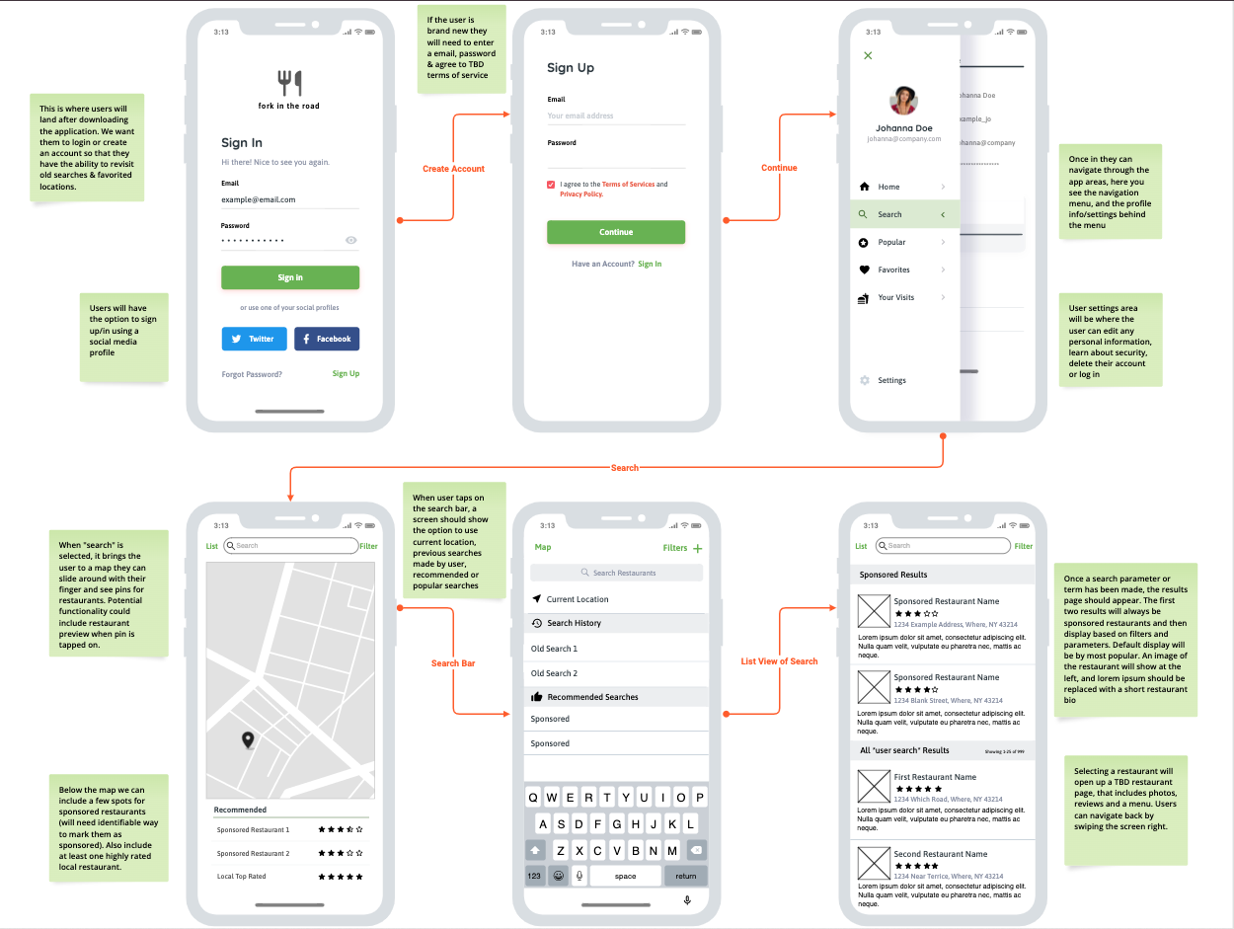
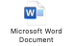
deliverables
Persona Profiles
Wireframe
Use cases
Users will include people looking for new restaurants, travelers, people looking for reviews, and looking for full menus to nearby restaurants
Users will create an account so use history can be saved and revisited
Users will be able to see restaurants based on location, rating, cuisine, popularity etc.
Users will be able to create reviews for restaurants they have visited
Users will be able to favorite or save restaurants they may want to visit later
Selecting a restaurant address should open 3rd party map app in user’s phone for directions to restaurant
Emily
Peggy
George
Notes:
On this slide I’ve included a few of the deliverables for ‘fork in the road’. On the far left I have included three persona profiles. As you all know, these are priceless tools when it comes to understanding the potential user base, and building out a design that works for them. Understanding the users of an app can help us to better predict their motivation for using the product as well as help us predict exactly how and when they will be using it. The better we know the users, the easier it becomes to predict needs and accommodate expectations. Please take some time after we wrap this presentation to review the persona profiles, I will be sure to email out the slideshow right after we exit this call.
Next, I have included a medium-fidelity mobile wireframe for ‘fork in the road’. I’ve been through a few rough iterations on paper for this application and wanted to show a moderate level of detail. There are still many more features that need to be accounted for. I’ve added my own initial comments on the wireframe in green stickies, if you all could add your own thoughts and comments in orange stickies that would be excellent as we look towards creating a high-fidelity wireframe. I love wireframes as a tool to show the client where we are at in the design process. They are pretty quick to draw up, and you do not need a ton of technical knowledge to create or digest one. They act as a tool to initiate conversation between our team and the client. These conversations are vital to creating a product that we are proud of, the client is happy with, and the user reaches for every time.
Lastly, I have written up a few use cases based upon the application vision from our client. These use cases are based on the user experience, but use cases often cover system interactions and reactions to input as well. I would like each of you to add additional use cases for the user and system. These will help us make sure the user -> system interaction is as smooth as possible, and potentially point out areas of functionality that may need improvement. While an easy, initial step of the design process, it is increasingly necessary the further we progress into the product design. The use cases may change and evolve as our vision of the design changes, and that is full expected. We want to create a logical and predictive flow to the application so that the user does not even realize how great and user-centric the design is.
I think it would be really helpful if one of you could do some market research of applications and products similar to ‘fork in the road’, as well as look into user interfaces that may be similar to what we are aiming for even if the product is completely different. A good place to start may be the realtor.com application, and yelp! If someone could get me a summary write up with interface screenshots and notes, that would be helpful as we move to create our high-fidelity wireframe.

Slide 8

summary
fork in the road is a restaurant locator application
Our initial design and prototype for this application with be for mobile devices
Looking ahead:
Review persona profiles
Review medium-fidelity wireframe, add any notes & thoughts on orange stickies
Add additional comprehensive use cases
Need market research & comparison write up
Our next meeting with the client set for 2/20/23 at 9am CT
Notes:
Alright, I know that was a lot of information and instruction for moving forward. I think we should all feel a little more comfortable with what ‘fork in the road’ is and what our client has in mind for the application. We have all agreed that mobile is the platform to start with for this application, but I think we now have a solid idea in mind for how we want to move forward with the introduction of a desktop version later on. I think the client will be on board and excited that we are already looking ahead at how to expand functionality for desktop when the time comes. I’ve summarized the upcoming tasks I need completed by each of you, so just make sure you review each of the persona profiles, take some time to look at the wireframe and add your notes, add comprehensive use cases, and get some market research put together. We meet again with the client in a little over a week, and I want to have a high-fidelity wireframe prepared for them as well as a portfolio of our deliverables. I love this application idea, and I am already very excited with the direction we are headed with it. I have no doubt in my mind that this is the right group of people for this task, you are all the best at what you do! Let’s break now, and get started on all of this. I’m thinking we do a check in meeting in two days to see where we are at, and make sure we haven’t run into any roadblocks! Like I said, I’ll get this presentation sent out to you all shortly!

Slide 9
thank you

